Slide 1
Data Sufficiency

Slide 2
Anatomy of a Data Sufficiency question:
While the genre of Data Sufficiency is unique, the structure is not – all Data Sufficiency questions are structured exactly the same, with three key elements:
The question stem (which may or may not contain important facts), the statements (always two statements), and the answer choices (which are always exactly the same).

Slide 3
Consider this example to see what a Data Sufficiency question will look like:
QUESTION STEM
By what percent was the price of a certain candy bar increased?
STATEMENTS
The price of the candy bar was increased by 5 cents.
The price of the candy bar after the increase was 45 cents

Slide 4
ANSWER CHOICES:
Statement (1) ALONE is sufficient, but statement (2) alone is not sufficient.
Statement (2) ALONE is sufficient, but statement (1) alone is not sufficient.
EACH statement ALONE is sufficient.
BOTH statements TOGETHER are sufficient, but NEITHER statement ALONE is sufficient.
Statements (1) and (2) TOGETHER are NOT sufficient.

Slide 5
If you’re relatively new to Data Sufficiency, the most striking feature of this question is likely the answer choices – they’re not numbers that might answer the questions, they’re more logical descriptions of when you might be able to answer the question.
The good news is that the answer choices are always the same, so you have plenty of opportunities to practice with them.
By the time you take the test, you shouldn’t even have to glance down at the answer choices because you’ll already know them so well, but that takes practice.

Slide 6
How to Approach Each Question
The following is an outline of the core approach that you should use every time you answer a Data Sufficiency question:
Read the question carefully and assess all information that is provided (or not provided) in the question stem. Organize this information so that you under-stand exactly what you will need to sufficiently answer the question.
Note: On many Data Sufficiency questions, the most important information is cleverly hidden in the question stem itself.
Avoid careless assumptions.

Slide 7
Do not assume anything that is not explicitly provided in the question stem or the statements that follow.
For instance, do not assume that x and y are integers unless it is explicitly given or can be deduced from the question stem or statements. Unless instructed otherwise, assume that fractions, negatives, and zero are all included in the set of potential values.
Make a quick judgment on which statement is easier to assess and start with that one.
The order in which statements are analyzed does not matter.
By starting with the easier statement, you simplify the decision tree and leverage easier information first.

Slide 8
To internalize the answer choices and have a system to attack them, you should use a system.
For every Data Sufficiency question, ask yourself the following questions (if starting with statement (1)):
Is the information in statement (1) alone enough to answer the question?
Is the information in statement (2) alone enough to answer the question?
Can I answer the question if I combine the information from statements (1) and (2)?
(Only ask this of yourself if neither statement alone was enough to answer the question.)

Slide 9
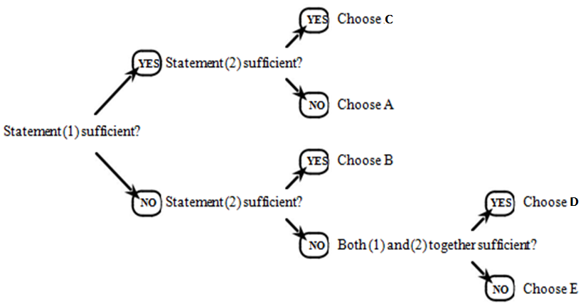
Data Sufficiency Decision Tree:
Assess each statement to determine whether it is sufficient or not, and this tree will lead you to the correct answer:

Slide 10
PRACTICE QUESTIONS:
Each problem consists of a question and two statements, labeled (I) and (II), in which certain data are given. You have to decide whether the data given in the statements are sufficient for answering the question.
Mark,
A. If statement (i) ALONE is sufficient, but statement (ii) alone is not sufficient to answer the question asked.
B. If statement (ii) ALONE is sufficient, but statement (i) alone is not sufficient to answer the question asked.
C. If EACH statement ALONE is sufficient to answer the questions asked.
D. If BOTH statements (i) and (ii) TOGETHER are sufficient to answer the question asked, but NEITHER statement ALONE is sufficient
E. If statements (i) and (ii) TOGETHER are NOT sufficient to answer the question asked and additional data specific to the problem are needed.

Slide 11
Q1.
Five persons are to be seated in a round table conference, who will be seated between Ram and Gita?
I. Ram will sit on the right of Vinay and on the left of Kamal.
II. There will be two persons seated between Vinay and Kamal.
Notes:
Ans: E

Slide 12
Q2.
When is the next bus scheduled for Mumbai from Delhi?
I. Every 30 minutes a bus is scheduled for Mumbai from Delhi. The return bus leaves Mumbai from Delhi every 45 minutes.
II. It is 4.45pm now .15 minutes ago one bus has left for Mumbai as per the schedule whereas the bus from Mumbai has arrived about 30minutes ago.
Notes:
Ans: D

Slide 13
Q3.
Among four friends P,Q,R and S, who has scored the highest runs in the cricket match?
I. P took more wickets than S but scored less runs than R.
II. Q scored more runs than P but took less wickets than S and R.
Notes:
Ans: E

Slide 14
Q4. Among five friends P,Q,R,S and T, who ranks 3rd in terms of salary obtained by them?
I. T’s salary is more than P and Q but not more than S.
II. R’s salary is the lowest among them.
Notes:
Ans: E

Slide 15
Q5.
How long does it take to reach city Y from city X?
I. Sangeeta was scheduled to leave the city X at 17.15 hours but got late by 45minutes and reached city Y at 16.15 hours the next day.
II. Sangeeta reached the bus stand of city X at 14.25 hours and got the bus after waiting for 35 minutes. She reached city Y at 3.15 hours the next day.
Notes:
Ans: C

Slide 16
Q6.
Among P, K, D and R, who could be the son of M?
I. P and K are sisters
II. D is the mother of K and wife of M.
Notes:
Ans:D

Slide 17
Q7.
Who among N, F, P, J and D is youngest?
I. P and J are younger than N and D.
II. F is younger than N, D and P but older than J.
Notes:
Ans:B

Slide 18
Q8.
Who among T, R and S is (are) to the East of P?
I. R, who is to the West of P, is not as near to S as P, S is in the farthest East.
II. P is not as far away from S and T
Notes:
Ans: A

Slide 19
Q9.
What is K’s rank from the bottom in a class of thirty students?
I.M’s position is 3rd from the top and there are five students between M and K.
II. P’s position is 4th from the bottom and there are 7 students between P and K.
Notes:
Ans: C

Slide 20
Q10.
Who is to the immediate right of Mohan when Mohan, Salil, Bhusan, Suresh and Jayesh are sitting around a circle facing at the centre?
I.Salil is 3rd to the left of Mohan.
II. Bhusan is between Salil and Jayesh.
Notes:
Ans: D

Slide 21
Q11.
What is the rate of interest p.a on a sum of Rs. 12000 deposited in a bank?
I. The difference between the simple interest and the compound interest is Rs 172.8.
II. The simple interest for two years is Rs. 2880.
Notes:
Ans: B

Slide 22
Q12.
What is the profit earned by selling the laptop for Rs 26,250?
I. The cost price of five such laptops is equal to selling price of 4 such laptops.
II. 25% of the profit is earned by selling each laptop.
Notes:
Ans: C

Slide 23
Q13.
How many women can complete a piece of work in 15 days?
I. If 12 women can complete the same piece of work in 20 days.
II. If 10 men can complete the same piece of work in 12 days.
Notes:
Ans: A

Slide 24
Q14.
Question: In which year was Rahul born ?
Statements:
I. Rahul at present is 25 years younger to his mother.
II. Rahul's brother, who was born in 1964, is 35 years younger to his mother.
Notes:
Ans: D From both I and II, we find that Rahul is (35 - 25) = 10 years older than his brother, who was born in 1964. So, Rahul was born in 1954.

Slide 25
Q15.
What is the age of C in a group of A, B, C, D and E whose average is 45 years?
I. Average of the ages of A and B is 53.
II. Average of the ages of D and E is 47.
Notes:
Ans: D

Slide 26
Q16.
In a library 10% of the books are added every year, what was the number of books that the library had in 1994?
I. During 1996, 10,000 books were added
II. During 1995, the library had 1,00,000 books
Notes:
Ans: C

Slide 27
Q17.
What is the difference in the ages of P and K?
I. P is 20 years older than M
II. M is 2 years younger than Z
Notes:
Ans: E

Slide 28
Q18.
D is the sister of C. how is D related to A?
I. A is the sister of B
II. B is the brother of C
Notes:
Ans: D

Slide 29
Q19.
A, B,C,D and E are sitting in a row. What is the position of B from the left end?
I. A is sitting at one end second right of D who is the immediate neighbour of C and B
II. E is to the left of B
Notes:
Ans: D ( EBDCA)

Slide 30
Q20.
How INDIA will be coded?
I. If ALIVE is coded as LAIEV
II. If JAPAN is coded as AJPNA
Notes:
Ans: C

Slide 31
Q21.
What will come in place of c in the series a,b,c,d,e?
I. a,b,c,d,e are five consecutive even numbers
II. common difference between two consecutive numbers is 2 and a is the second smallest natural number
Notes:
Ans: B

Slide 32
Q22.
Who among A,B,C,D and E is the smallest?
I. B is taller than E and D is taller than A but smaller than E.
II. D is not the tallest and C is not the smallest
Notes:
Ans: D (C>B>E>D>A)

Slide 33
Q23.
X borrowed Rs. 1000 from Y on SI. What is the rate per annum?
I. After 4yrs, X paid Rs. 100 as interest.
II. After 4yrs, X paid Rs. 1100 to settle the loan.
Notes:
Ans: C

Slide 34
Q24.
What is the total salary of Mr. X and his wife at present?
I. Salary of X and his wife together is 20% more than what they earned last month.
II. Last month salary of X was Rs. 600 more than that of his wife.
Notes:
Ans: E

Slide 35
Q25.
A figure is composed of ten 1- inch cubes. What is the weight?
I. The cubes are arranged in five rows to two each.
II. The cubes have an average weight of 1 ounce each.
Notes:
Ans: B

Slide 36


